Slide 1

rsyslog and cron
Chapter 8

Slide 2
rsyslog
Send output to various destinations
text files (/var/log/)
SQL databases
other hosts (remote logging)
Although there have been many different syslog daemons over the years, rsyslog has emerged as the standard

Slide 3





what can we use it for?
Centralized logging for *all* devices is a great aid in troubleshooting
One place to look
Coordinated time
Local and remote locations

Slide 4
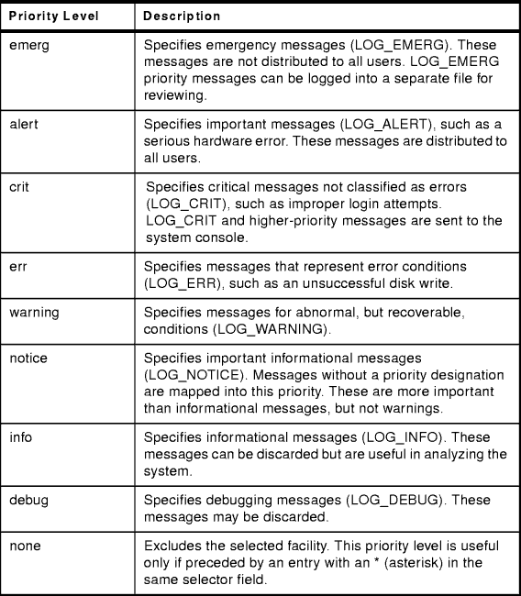
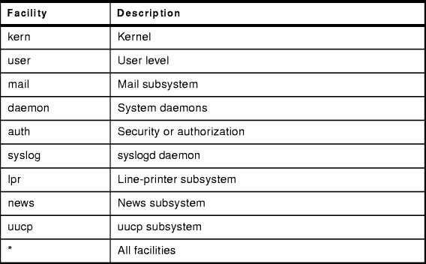
log messages
made up of facility and priority

Slide 5
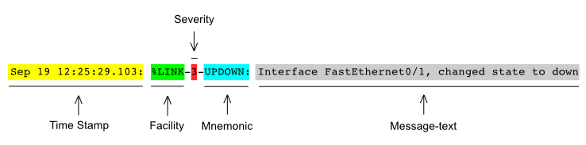
syslog message format(ish)

Slide 6
/etc/rsyslog.conf
Modules
local system logging
kernel logging
UDP/TCP syslog reception
Global Directives
Set default values for logging
Specific rsyslog configurations are processed in separate files in /etc/rsyslog.d/*.conf

Slide 7
/etc/rsyslog.d/20-ufw.conf
# Log kernel generated UFW log messages to file
:msg,contains,"[UFW " /var/log/ufw.log
# Uncomment the following to stop # logging anything that matches the last rule. # Doing this will stop logging kernel generated # UFW log messages to the file # normally containing kern.* messages # (eg, /var/log/kern.log) #& stop

Slide 8
/etc/ryslog.d/50-default.conf
# # First some standard log files. Log by facility. #
auth,authpriv.* /var/log/auth.log *.*;auth,authpriv.none -/var/log/syslog
kern.* -/var/log/kern.log
mail.* -/var/log/mail.log

Slide 9
using logger for testing
logger -p facility.level -f /path/to/logfile -t logtag
-p = enter the message with the specified priority defaults to user.notice
-f = log the contents of the specified file
-t = mark each line with a specified tag defaults to logged in user
logger –f /scripts-2331/mismatch.log –t myswitch

Slide 10
/var/log/syslog with tag
Apr 3 18:34:57 cushing-dave daveswitch: %CDP-4-DUPLEX_MISMATCH: duplex mismatch discovered on FastEthernet0/2 (not full duplex), with Switch FastEthernet0/1 (full duplex).
Apr 3 18:34:57 cushing-dave daveswitch: %CDP-4-DUPLEX_MISMATCH: duplex mismatch discovered on FastEthernet0/1 (not half duplex), with Switch FastEthernet0/2 (half duplex).
Apr 3 18:34:57 cushing-dave daveswitch: %CDP-4-DUPLEX_MISMATCH: duplex mismatch discovered on FastEthernet0/2 (not full duplex), with Switch FastEthernet0/1 (full duplex).
Apr 3 18:34:57 cushing-dave daveswitch: %CDP-4-DUPLEX_MISMATCH: duplex mismatch discovered on FastEthernet0/1 (not half duplex), with Switch FastEthernet0/2 (half duplex).

Slide 11
Creating our own template
sudo nano /etc/syslog.d/00-myswitch.conf
# Set up a template for per tag logging $template PerTagLog,"/var/log/%syslogtag%.log"
# Only grab messages for our particular switch if $syslogtag contains 'myswitch' then -?PerTagLog &~

Slide 12
what does this do?
syslog messages with the tag myswitch will get their own log file:
/var/log/myswitch:.log
They will no longer appear in /var/log/syslog

Slide 13
what else can we do?
remote logging to other servers
set up our server as a remote logging server
Specialized tools will give better insight
rsyslog is good for small shops

Slide 14
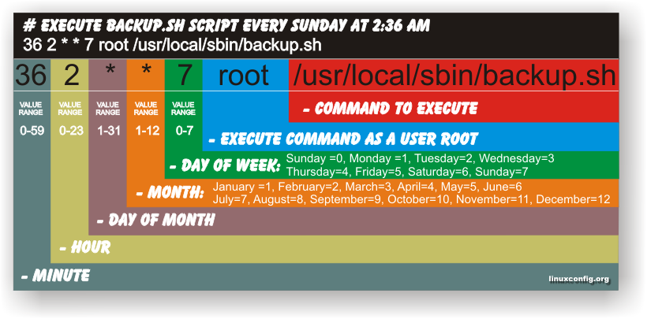
cron (task scheduler)

Slide 15
cron
To edit the crontab with nano, use the following line:
sudo EDITOR=nano crontab -e
To check to see if your cron jobs ran:
grep “CRON” /var/log/syslog
min | hour | mday | month | wday | command 00 | 16 | * | * | * | ufw status > /etc/ufw.stat 5,15| 2-6 | 1,15 | 8-10 | * | systemctl restart xinetd 00 | 00 | * | * | 7 | systemctl status xinetd */2| * | * | * | * | ping -c10 10.128.0.3

Slide 16
use tcpdump to listen for traffic
see if you ping job is working:
sudo tcpdump -i ens4 -vvv icmp
my-server > target-server: ICMP echo request, id 7424, seq 10, length 64
20:00:10.833401 IP (tos 0x0, ttl 64, id 7561, offset 0, flags [none], proto ICMP (1), length 84)
target-server > my-server: ICMP echo reply, id 7424, seq 10, length 64

Slide 17

tcpdump
sudo tcpdump -i ens4 -vvv ‘icmp’
-i = interface to listen on -vvv = very, very verbose ‘icmp’ = filter (like wireshark filters)
tcpdump is similar to command line wireshark. Learn to use it for testing and troubleshooting.

